Slide 1

Mental Health Challenge: Schizophrenia
Points to keep in mind
We are using some clinical terminology when describing symptoms, as per DSM (recall it is rooted in a medical model)
Family resemblance view: one size does not fit all; each person’s symptom frequency and expression is different, though there will be some similarity
i.e. some resemblance, but not identical
Like many clinical syndromes, there is a RANGE of expression
E.g. schizophrenia, schizotypal personality
We are actively discussing symptoms, BUT bear in mind that someone with a diagnosed condition does not always have symptoms.
Just like irritable bowel syndrome, eczema, or HSV1/2 (or any other physical condition), symptoms manifest at certain times (“episode”, “flare up”)

Slide 2
Schizophrenia
“split mind”
Not “split personality”/dissociative identity disorder
Schizophrenia is more common than DID
<1% prevalence rate in Canada for schizophrenia
1% worldwide prevalence rate

Slide 3
Main Features/Symptoms
Delusions and irrational thoughts
Paranoid delusions
Delusions of grandeur
Delusions of persecution
Train of thought and speech
Language and communication deteriorates
“word salad”

Slide 4

Hallucinations
Perceptual distortions
E.g. Hearing voices
Disturbed Behaviour or Catatonia
Emotional bluntedness
Responses don’t match situations
Lack of self-care (breakdown in adaptive functioning)
Catatonia: withdrawal, maintaining rigid bodily postures

Slide 5
Note: Schizophrenia subtypes
Paranoid, Catatonic, Disorganized
DSM 5 removed this subtyping
The subtypes do not show distinct trajectories or responsiveness to treatment
DSM-V focuses on severity of main symptoms
Fits with a dimensional model

Slide 6
“Positive” Symptoms
“Negative symptoms”
the presence of abnormal behaviours
Behavioural excesses or peculiarities
Absence of normal behaviours
Behavioural deficits

Slide 7
Onset
Adolescence to early adulthood
Can be sudden or gradual
Men and women – equal rates
But men show earlier onset
High mortality rate (suicide)

Slide 8
Michelle: Her Experience of Living with Schizophrenia
https://www.youtube.com/watch?v=C7Jl9_59tfY

Slide 9
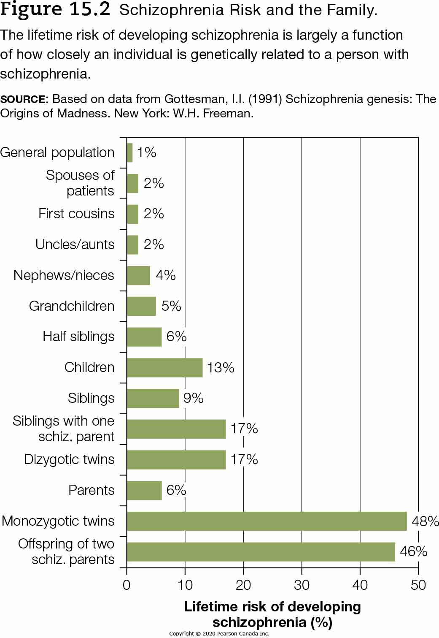

Genetic factors
Twin, family, adoption studies suggest a genetic predisposition to schizophrenia
48% concordance rate for MZ twins vs 17% DZ twins

Slide 10
Neurotransmitters
Dopamine, norepinephrine, glutamate, and serotonin are all disrupted in some way
Indirect evidence: PCP drug data
Excess dopamine NT was primary hypothesis at one point, but…
Observed differences in dopamine receptors (not just the amount of dopamine) in mesolimbic regions (“reward pathway”)
See this link for a 2 minute overview: https://www.youtube.com/watch?v=4t1EsfhPBTk
There are 4 known types of D receptors; some appear to be involved in positive symptoms, some in negative symptoms
D receptors are over-active in mesolimbic areas and under-active in pre-frontal areas (Brisch et al., 2014)

Slide 11
Structural differences in brain
Enlarged ventricles (fluid-filled spaces) in brain (note cause & effects issue though)
Increased sulci size (grooves between ridges of brain)
Frontal lobe functioning

Slide 12
Causes (continued)
Stress
High stress can trigger symptoms in individuals who are already predisposed
Early predispositions might be observable (e.g., emotion bluntedness)
Viral infections, malnutrition during pregnancy
Family stress factors
Overly high expression of emotion related to relapses after treatment
“criticism, hostility, overinvolvement” (Lilienfeld et al., 2020, p. 578)

Slide 13
Summary
Schizophrenia involves thinking, emotion, and behaviour – and biology
Core symptoms include delusions, hallucinations, break down of thinking and language, self-care
Genetic factors play a role
Keep diathesis-stress model in mind
Structural differences
Stress

Slide 14
Treatments for Schizophrenia
Biomedical
Social and Behavioural treatments

Slide 15
Psychosurgery
Early 1900’s
Prefrontal lobotomy as a treatment for schizophrenia
nerves connecting frontal lobe to thalamus are cut
Caused extreme apathy as a result, “zombie”-like
In the 1950’s, the use of this procedure diminished

Slide 16
Pharmacotherapy
Drugs aim to change brain’s chemistry
1950’s – Thorazine (AKA Chlorpromazine)
Treatment for schizophrenia
This period was the beginning of the “pharmacological revolution” for treating mental disorders
Thorazine is an anti-psychotic medication
Is a dopamine antagonist

Slide 17
Thorazine works on some symptoms of schizophrenia (mainly positive symptoms)
but not for others
Tardive Dyskinesia (involuntary facial movements & grimacing)
Side effect of Thorazine (and other typical anti-psychotic medications)

Slide 18
Atypical anti-psychotic medications are newer (e.g. Clozapine)
Act on dopamine and serotonin
Seem to work fairly well for ‘negative symptoms’ of schizophrenia
Does not cause TD, but dizziness, nausea, sedation, seizures, irregular heartbeat are side effects

Slide 19
Applying Rewards and Punishments: Token Economies
Usually carried out in institutional settings (large scale)
Uses reinforcements to promote desired behaviours
Tokens given for desirable behaviour, and then can be exchanged for privileges/reinforcers
Tokens removed for unwanted behaviour

Slide 20
Token economies
This system does not cure people
But they reduce some behavioural problems that accompany some disorders
Some who are institutionalized may lose motivation for everyday self-care
Tokens can help bring back these behaviours
Criticisms of this method?

Slide 21
Social, Behavioural Treatments
Strategic Family therapy
Teaching communication skills
Learning to reduce and resolve conflict
Behavioural Rehearsal
Role-playing (useful not just for schizophrenia, but also depression and social anxiety)
The combination of medication and psychosocial therapies greatly reduces relapse of symptoms

Slide 22
Social Skills Training
Uses modeling and reinforcement to shape appropriate adjustment skills
Working in group setting
Usually involves a series of steps
Assertiveness training
Express thoughts in social acceptable manner
Learn to avoid extreme reactions (submissiveness or aggression)
For example, to teach conversational skills, the therapist might:
Discuss appropriate verbal responses
May be followed with a videotaped demonstration
Role play a conversation
Therapist gives feedback
“Assign” client to practice skills before next session

Slide 23
The End

